Slide 1
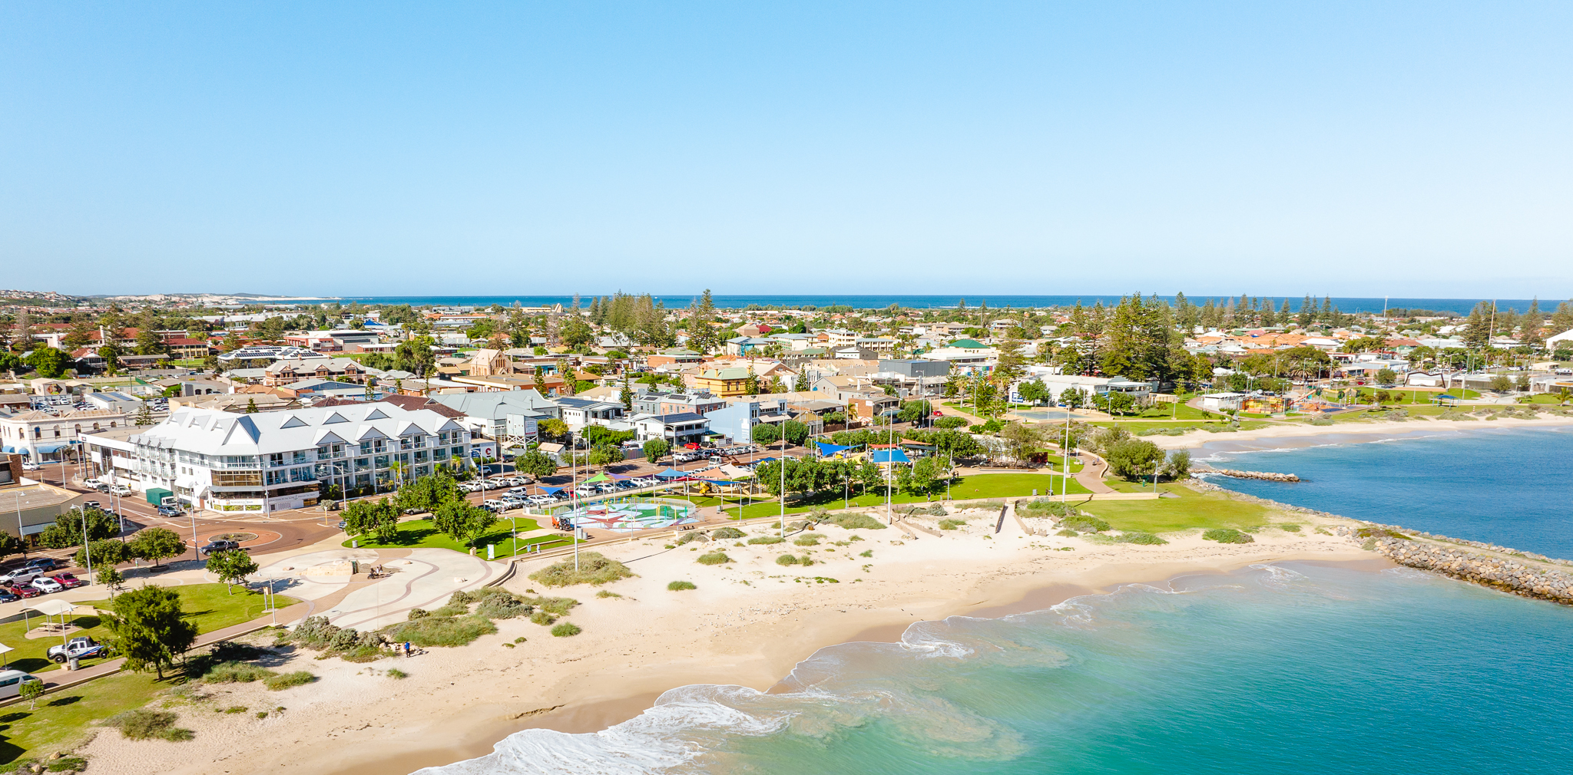
Advice from a new(ish) Councillor
Cr Steve Cooper

Slide 2
How much reading is there?
Lots!!!!
It is important to do the reading so you are prepared.
There are:
Three (3) Agendas a month (Concept Forum, Agenda Forum, Ordinary Meeting of Council)
Briefing Notes from officers on particular topics
There are lots of general emails

Slide 3
What about e-mails, phone calls, ICT support?
The City provides laptop/tablet plus a sim
Agendas are provided electronically only – reduces paper usage, so you need to know your way around computer basics (Outlook, Word, One-Drive)
You will receive council related phone calls

Slide 4
How do I learn meeting procedures?
It takes a while to get the swing of it
The Mayor and Councillors are understanding while you learn
Meeting Standing Orders are provided in print and are with you at the Agenda and Ordinary Meetings
WALGA training is available
CEO and Governance officers can also help

Slide 5
How long do meetings last?
Depends on the Chair and the Agenda
Usually around one (1) hour
Maximum allowed length is three (3) hours unless Council agrees to extend
Very efficient, organised and structured meetings – a good thing – but means you have to have completed your reading otherwise you can get lost quick

Slide 6
Do I need to be a good public speaker?
Helpful, but not essential
The Mayor speaks publicly for the City
Confidence can be gained in our smaller sized meetings, comes with practice, make notes or dot points to speak if you wish
You will need to be able to speak in meetings to make your view known and to try to persuade your fellow councillors to agree with you

Slide 7
Is there support available?
Yes
You can talk/email your fellow Councillors
You can lodge a Councillor Help Desk (potholes, long grass, dogs, cats etc.)
You can ring the CEO
You can talk to WALGA

Slide 8
What about Committees?
There are various committees you can get involved in
Committee membership is determined at the first Council meeting (a voting process)
Please don’t nominate for a committee if you can't regularly attend as it impacts quorums
Might mean being on 2 to 3 committees – that hold meetings largely twice per year, with a meeting time of one (1) hour
Not onerous, but do the reading

Slide 9
What do I do if approached in public?
Listen
Provide them with options to contact the city directly if they have not yet done so (email, phone, web chat, letter, ‘snap, send, solve’)
Some issues are easy – grass is long in the park, a hole in the road
Some issues are not easy – barking dogs, planning, neighbours …
Listen
You do not need to solve
You are a conduit – pass the info on and then follow up for the resident
You will get approached at inconvenient times – grocery shopping

Slide 10
I don’t know about CGG operations?
CEO is responsible for the operations of CGG
Basic financial knowledge is helpful as the biggest annual task of the Council is establishing the annual budget
WALGA training is available – 5 modules are essential – to be completed within the first 12 months
Fellow Councillors and officers can help

Slide 11
